Slide 1
Condor Philosophy
Greg Thain

Slide 2
Agenda
The other talks are about the hows of HTCondor
This talk is about the why

Slide 3
First Principles: Who
1) Owner: $$$ (€€€, £££ ???)
2) Job Submitter
3) Administrator

Slide 4
The Philosophy on 1 slide
To reliably run as much work as possible
on as many machines as possible
(in order of precedence)

Slide 5
The other side – administrator’s view
To maximize machine utilization
ABCs:
Always
Be
Computing
“No Cycle Left Behind”

Slide 6
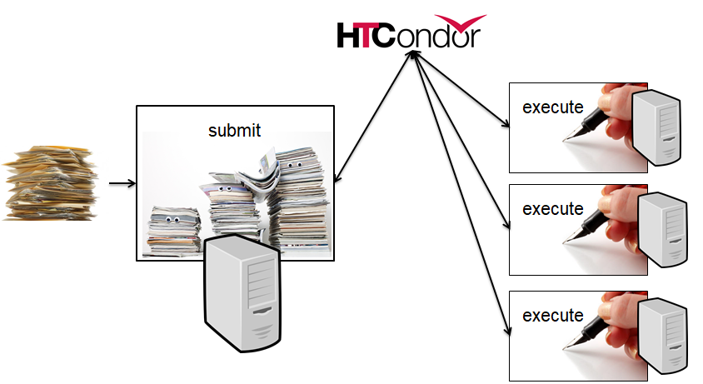
The Unstated Assumption
“Work” can be broken up into smaller jobs
Smaller the better (up to a point)
files as ipc
dependencies via dag
Optimize time-to-finish
not time-to-run
*whole talk about this

Slide 7


Overview of condor: 3 sides
Execute
Submit
Central Manager

Slide 8
To reliably run…
Reliability 1st priority
We can make HTCondor fast enough
w/o sacrificing any reliability – no screw polishing

Slide 9
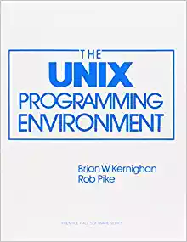
To reliably run…
Unix process per daemon
Each has failure semantics
Each cleans up on exit
Each has responsibility
Perhaps many per machine

Slide 10
To reliably run… requires parent
Small condor_master runs on all condor machines
Responsibilities:
Like systemd init,
starts, restarts, kills children
condor_on,
condor_off, condor_reconfig
Detects hung kids and kills them(!)
Exits if disk full
Runs Linux kernel tuning script
master
On/off/restart
commands
TCP
Fork/exec
Fork/exec
child1
child2

Slide 11
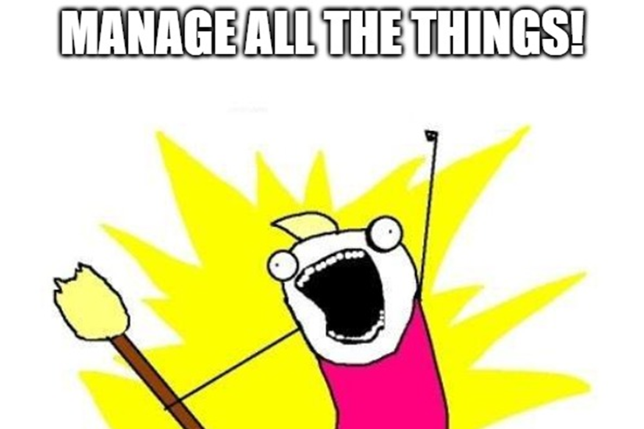
master manages process
Manage:
Remove what you create
and what they created…
Measure what you create
And report it
Limit what you create

Slide 12
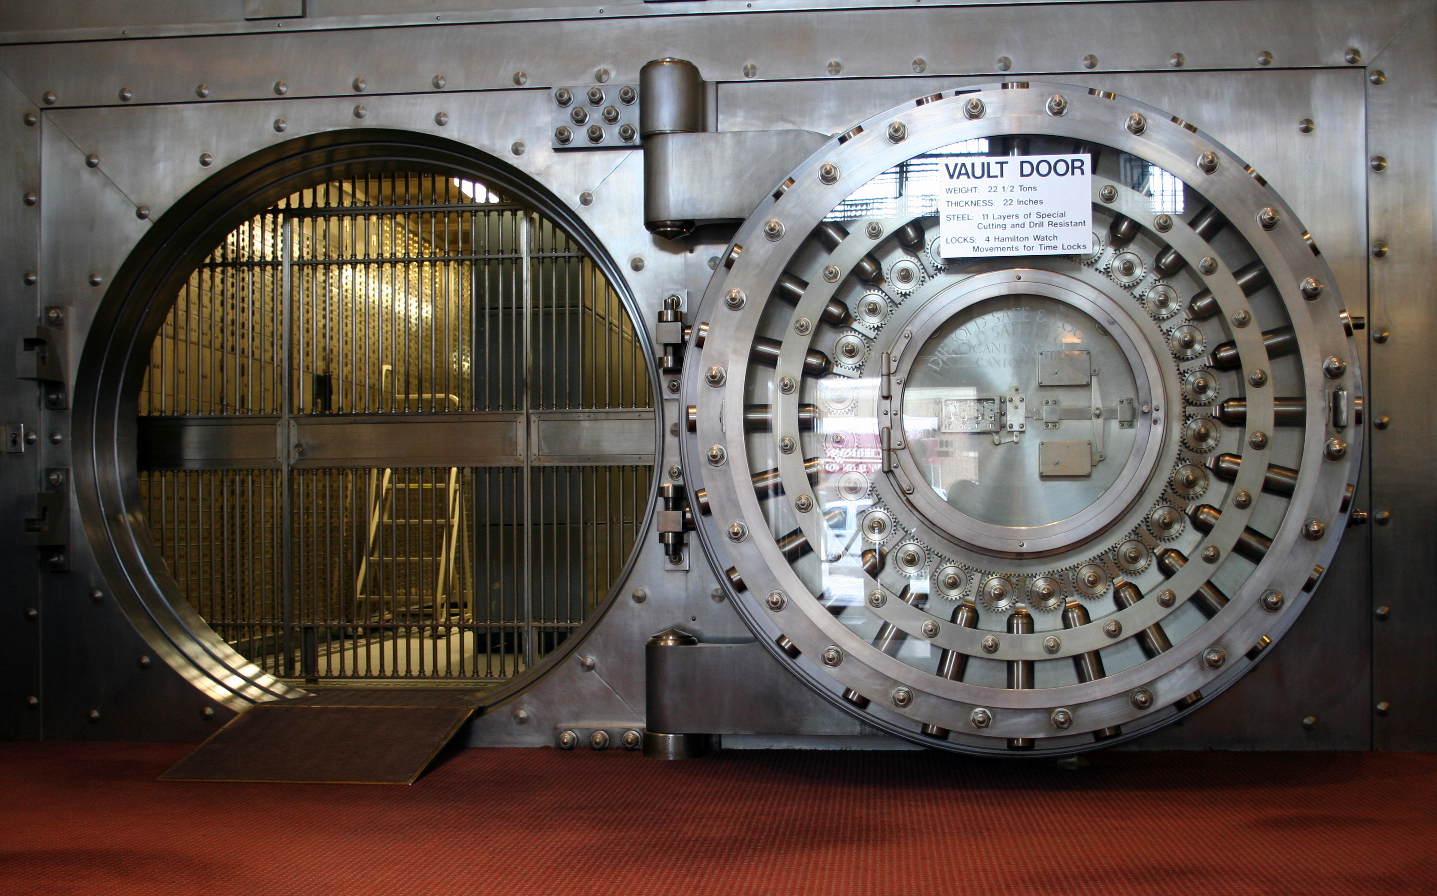
… as many jobs…
Requires a scheduler, the condor_schedd
Users submit jobs to schedd
Schedd is a database
reliable, slow
On crash, all restart
To support many jobs,
reliably means…

Slide 13
Scaling via many submit points
Execute
Central Manager
Submit machines

Slide 14
Scaling via many submit points
Adding submit points just helps scaling
Allows submit near the user
“Submit locally, run globally”

Slide 15
But the schedd doesn’t schedule
It does a little
Schedd has jobs, can request machines
But only uses the machines given to it
Scheduling, not planning

Slide 16
The shadow manage running, remote jobs
One process per running job on submit
Responsible for job’s policy remotely
Tells the worker node what to do
Expensive? Yes – worth it

Slide 17
…on as many machines
Implies machines are heterogeneous
Could be foreign pools
Could be same pool with different config
Could be places without shared filesystem

Slide 18


Two-faced nature of HTCondor
Split responsibility:
Worker side
Submit side
We encourage different config on both sides
Always focusing on responsibility of the side
Always consider where responsibility goes

Slide 19
The startd
Startd represents the policy of the machine
Creates “slots”, places for jobs to run
Could conflict with job’s policy?
Who wins?
Always the machine – the job is a guest

Slide 20
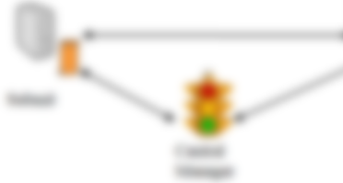

Startd Mission Statement
Near sighted
3 inputs only:
Machine
Running Jobs
Candidate Running Job
Knows nothing about the rest of the system!

Slide 21
Things the startd can do
Only run some kinds of jobs
Preempt one job for another
Only run 1 job of some type
Expose and match custom resource

Slide 22
But the startd doesn’t run job
Doesn’t run jobs directly,
Creates (and manages!)
child process, the starter

Slide 23
The Starter
Startd manages machine, starter job
When job starts, startd spawns starter
One starter per job, thus one per slot

Slide 24
Starter Responsibilities
Starter manages running job on machine:
Create environment for job
Monitor, report job resource usage home
Creates “Universe” metaphor
Clean up after job
Condor Philosophy: renters clean up after use
(Startd cleans up after starter…)
File Transfer

Slide 25

A few words on file transfer…
We can use shared FS or File Transfer
Prefer File Transfer:
Managed
Portable
Declarative

Slide 26
Moving on to the middle side…
Execute
Submit
Central Manager

Slide 27
The Central Manager
Part 1: The Collector
The central database
All in memory, lightweight
Every thing reports to collector
Everything is a classad
condor_status queries

Slide 28
The Collector
Looses everything when it crashes
Protocol is always be updating
Not a central point of failure
Garbage collects if no updates

Slide 29
The Negotiator
Other “half” of scheduling
Slow, allocates machines to user
Two phase scheduling:
Slow, negotiator rebalancing
Fast, schedd scheduling and reusing of claims
Not a single point of failure

Slide 30
Claiming Protocol
Central Manager
Q
Negotiator
Collector
J
S
S
Submit Machine
Execute Machine
CLAIM
J
S
S
Q
Schedd
Startd
S
J
J
J
Submit
30
Notes:
30
Steps
1. Startd sends collector ClassAd describing itself. (The Schedd does as well, but it has nothing interesting to say yet.)
2. The user calls condor_submit to submit a job. The job is handed off to the schedd and condor_submit returns.
3. The schedd alerts the collector that it now has a job waiting.
4. The negotiator asks the collector for a list machines able to run jobs and schedd queues with waiting jobs.
5. The negotiator contacts the schedd to learn about the waiting job.
6. The negotiator matches the waiting job with the waiting machine.
7. The negotiator alerts the schedd and the startd that there is a match.
8. The schedd contacts the startd to claim the match.
9. The schedd starts a shadow to monitor the job.
10. The startd starts a starter to start the job.
11. The starter and the shadow contact each other.
11. The starter starts the job.
12. If the job is using the Condor syscall library (typically through being condor_compiled), it will contact the shadow to access necessary files.

Slide 31
Claim Activation
Central Manager
Negotiator
Collector
Submit Machine
Execute Machine
Schedd
CLAIMED
Startd
Activate
Claim
Starter
Job
Shadow
31
Notes:
31
Steps
1. Startd sends collector ClassAd describing itself. (The Schedd does as well, but it has nothing interesting to say yet.)
2. The user calls condor_submit to submit a job. The job is handed off to the schedd and condor_submit returns.
3. The schedd alerts the collector that it now has a job waiting.
4. The negotiator asks the collector for a list machines able to run jobs and schedd queues with waiting jobs.
5. The negotiator contacts the schedd to learn about the waiting job.
6. The negotiator matches the waiting job with the waiting machine.
7. The negotiator alerts the schedd and the startd that there is a match.
8. The schedd contacts the startd to claim the match.
9. The schedd starts a shadow to monitor the job.
10. The startd starts a starter to start the job.
11. The starter and the shadow contact each other.
11. The starter starts the job.
12. If the job is using the Condor syscall library (typically through being condor_compiled), it will contact the shadow to access necessary files.

Slide 32
Repeat until Claim released
Central Manager
Negotiator
Collector
Submit Machine
Execute Machine
Schedd
CLAIMED
Startd
Activate
Claim
Starter
Job
Shadow
32
Notes:
32
Steps
1. Startd sends collector ClassAd describing itself. (The Schedd does as well, but it has nothing interesting to say yet.)
2. The user calls condor_submit to submit a job. The job is handed off to the schedd and condor_submit returns.
3. The schedd alerts the collector that it now has a job waiting.
4. The negotiator asks the collector for a list machines able to run jobs and schedd queues with waiting jobs.
5. The negotiator contacts the schedd to learn about the waiting job.
6. The negotiator matches the waiting job with the waiting machine.
7. The negotiator alerts the schedd and the startd that there is a match.
8. The schedd contacts the startd to claim the match.
9. The schedd starts a shadow to monitor the job.
10. The startd starts a starter to start the job.
11. The starter and the shadow contact each other.
11. The starter starts the job.
12. If the job is using the Condor syscall library (typically through being condor_compiled), it will contact the shadow to access necessary files.

Slide 33
Repeat until Claim released
Central Manager
Negotiator
Collector
Submit Machine
Execute Machine
Schedd
CLAIMED
Startd
Activate
Claim
Starter
Job
Shadow
33
Notes:
33
Steps
1. Startd sends collector ClassAd describing itself. (The Schedd does as well, but it has nothing interesting to say yet.)
2. The user calls condor_submit to submit a job. The job is handed off to the schedd and condor_submit returns.
3. The schedd alerts the collector that it now has a job waiting.
4. The negotiator asks the collector for a list machines able to run jobs and schedd queues with waiting jobs.
5. The negotiator contacts the schedd to learn about the waiting job.
6. The negotiator matches the waiting job with the waiting machine.
7. The negotiator alerts the schedd and the startd that there is a match.
8. The schedd contacts the startd to claim the match.
9. The schedd starts a shadow to monitor the job.
10. The startd starts a starter to start the job.
11. The starter and the shadow contact each other.
11. The starter starts the job.
12. If the job is using the Condor syscall library (typically through being condor_compiled), it will contact the shadow to access necessary files.

Slide 34
When is claim released?
When relinquished by one of the following
lease on the claim is not renewed
Why? Machine powered off, disappeared, etc
schedd
Why? Out of jobs, shutting down, schedd didn’t “like” the machine, etc
startd
Why? Policy re CLAIM_WORKLIFE, prefers a different match (via Rank), non-dedicated desktop, etc
negotiator
Why? User priority inversion policy
explicitly via a command-line tool
E.g. condor_vacate

Slide 35
Architecture items to note
Machines (startds) or submitters (schedds) can dynamically appear and disappear
Key for expanding a pool into clouds or grids
Key for backfilling HPC resources
Scheduling policy can be flexible and very distributed
CM makes a match, then gets out of the way
Distributed policy enables federation across administrative domains
Lots of network arrows on previous slides
Reflects the P2P nature of HTCondor

Slide 36
Quiz Time
How to hold job that runs > 24 hours
Or rather, where?
On the submit machine?
Or Execute Machine?
Discuss!

Slide 37
Quiz Answer
It depends!
Property of job or property of machine?

Slide 38
Conclusion
Thank you, and let’s continue discussing…

